Slide 1
Transmission System management & Ancillary services
Hubert Lemmens

Slide 2
Agenda
Elia Group
Electricity market
Role of the different players
Elia products and services
Balancing
Other Ancillary Services

Slide 3
Agenda
Elia Group
Electricity market
Role of the different players
Elia products and services
Balancing
Other Ancillary Services

Slide 4
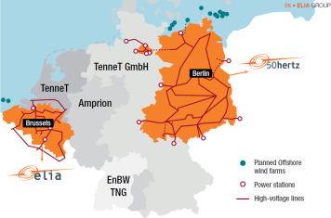
Elia Group - reliable and resilient networks
Ownership
Elia
100% of 380-150kV network
94% of high voltage network (70-30kV)
50Hertz
100% of 380-220kV network
    34% of the German 380kV network
    19% owner of the German 220kV network
Age of networks
Elia
Less than 15 years for 50% of underground cables
Less than 25 years for 50% of lines & substations
50Hertz
Around 10 years for 90% of the network (refurbished after German reunification in 1989)

Slide 5


Elia + 50Hertz Transmission = Top 5 in Europe
 |  |  | Elia Group
110-380 kV lines and cables |  |  | 13,431 km
30 tot70 kV lines and cables |  |  | 4,800 km
Substations |  |  | 872
Served territory (km2) |  |  | ~ 143,000
Direct consumers |  |  | ~ 130
Inhabitants |  |  | > 30m
Staff (FTE) |  |  | ~ 1,900
Regulated Asset Base (RAB) |  |  | € 5,843m
5
Notes:
De Elia Groep beheert zo een net van in totaal meer dan 18 000 km lang in een gebied van zo’n 143 000 km² en zorgt voor een betrouwbare en kwaliteitsvolle elektriciteitsvoorziening voor zo’n 29 miljoen Europeanen. De onderneming telt zo’n 1800 medewerkers, waarvan ongeveer twee derden in België en één derde in Duitsland. Naast de gereguleerde kernactiviteiten als transmissienetbeheerder ontwikkelt de Elia groep ook andere activiteiten vanuit een strategie om meerwaarde te creëren door te diversifiëren, synergieën te creëren en know-how te delen.
Via opdrachten in het buitenland en in eigen land, in bv engineering en consultancy
En via investeringen in infrastructuur in het buitenland die meerwaarde creëren – zowel financieel als inzake knowhow - en die het risicoprofiel van de onderneming gunstig beïnvloeden.
5

Slide 6
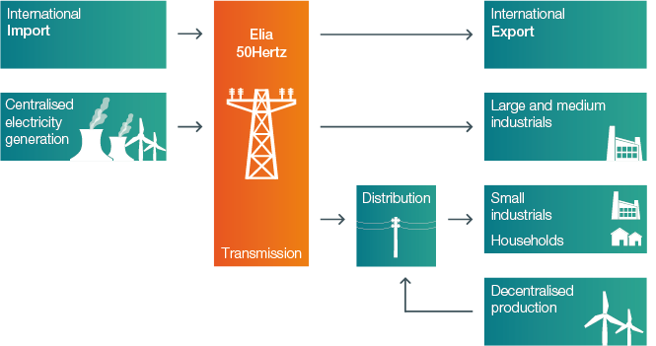
TSO:
► Essential link between # stakeholders
Notes:
Dit schema vat heel duidelijk het elektrische landschap samen.
De TNB vormt de link of anders gezegd de schakel tussen de producenten aan de ene kant (in België of in het buitenland - de injecties worden berekend aan de grens) en de verbruikers aan de andere kant (gevestigd in België of in het buitenland - de afnames worden berekend aan de grens).
Grote industriële klanten zijn rechtstreeks aangesloten op het transmissienet; kleinere verbruikers (die ook industriële verbruikers kunnen zijn maar ook huishoudelijke verbruikers) worden van elektriciteit voorzien via de distributienetbeheerders die m.a.w. dezelfde rol als Elia vervullen maar op een lager spanningsniveau.
De activiteiten van de netbeheerders (zowel van transmissie als distributie) zijn gereguleerde activiteiten. Hun activiteiten staan m.a.w. onder het toezicht van de regulatoire instanties. Hun tarieven worden goedgekeurd door de bevoegde regulator. Die tarieven dekken de opgelopen kosten en garanderen een eerlijke vergoeding van het kapitaal dat in de installaties alsook voor de te verlenen diensten wordt geïnvesteerd.
Zowel de producenten als de leveranciers ontsnappen niet aan de concurrentie. Hun prijzen worden bepaald door de markt.

Slide 7
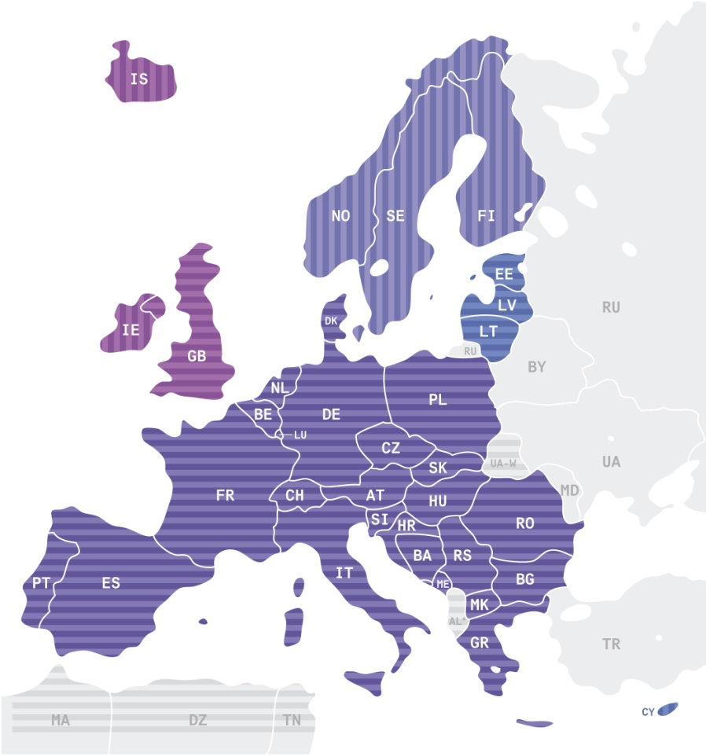
The transmission grid: key in energy policy
    The European transmission system:
    34 interconnected countries
      532 million consumers
      880 GW installed generation
      3.200 TWh/year consumption
      380 TWh/year international exchanges
      The European transmission grid:
      305.000 km interconnections
      → A remarkable technological accomplishment of the 20th century !
Notes:
7

Slide 8

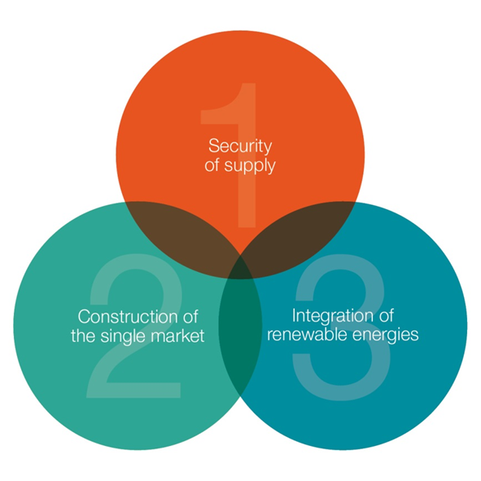


Elia has a central role within this energy-(r)evolution
Arbeitsstand
3 Tasks
3 Challenges
Infrastructure
Management
System operation
+ Strategic Reserve (new)
Market facilitation

Slide 9
Agenda
Elia Group
Electricity market
Role of the different players
Elia products and services
Balancing
Other Ancillary Services

Slide 10
EU Market Model
Forward
Manage forward price and vol. Risk
Arbitrage
Maintenance planning
Investment planning
Day Ahead
Manage STprice and vol. Risk
Close forward positions
Generation optimization (Make or buy)
Intraday
Volume adjustment/fine tuning (T°, wind,…)
Outage management
Balancing
System security

Slide 11
Power Markets: general framework
Forward
Day ahead
Intraday
Balancing
Reserves
Energy only markets
Capacity market
Multilateral market
TSO is single buyer

Slide 12



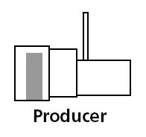
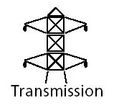
Different electricity markets
Retailers
Retail Market
Wholesale Market
OTC and Exchange
Traders
Balancing
Market

Slide 13
Agenda
Elia Group
Electricity market
Role of the different players
Elia products and services
Balancing
Other Ancillary Services

Slide 14
Market actors
Producers
Suppliers
  Sell the energy to the consumers
Traders
  Buy and sell the energy on wholesale markets, but don’t supply
Grid Users
  Are connected to the Grid (Transmission or Distribution)
  Take energy off or inject energy in the Grid
Grid operators (Transmission / Distribution)
  Build and maintain Grid
  Guarantee security and quality of supply
  Control and manage balance, voltage, frequency and congestions
  Promote the opening of the marke
  New roles appear: prosumers, aggregators
14

Slide 15
Roles and responsibilities
Resource Adequacy
Energy Balancing
Ancillary
service
Responsibility: government/market
Tools:
Measurement/ forecasts
Stable framework
Capacity remuneration schemes
Strategic Reserves
Responsibility: energy market actors
Tools:
Direct control (dispatchable load)
Response to price signals (non-dispatchable load)
Responsibility: TSO as buyer - generation&load as provider
Tools:
Direct control (dispatchable load) options (pre-contracted)
DSOs involved, especially when Distribution grid congestion issues

Slide 16
Agenda
Elia Group
Electricity market
Role of the different players
Elia products and services
Balancing
Other Ancillary Services

Slide 17
Product overview
In the interactions with the market, we distinguish following categories of products:
Services supplied to Grid Users
Connection to the Grid
Access to the Grid
    Use of the Grid
    Supply of ancillary services
Management of balance
Allocation of interconnection capacity
Services contracted with third parties
Capacity reservation for ancillary services
Supply of energy for ancillary services
Strategic reserves
Coordination of Injection of Production (CIPU)
Notes:
II Access en bold – OK or NOK

Slide 18
Elia Group
Electricity market
Role of the different players
Elia products and services
Balancing
Other Ancillary Services

Slide 19
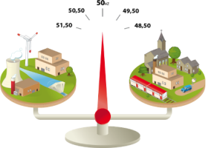
Why is balance needed between electricity generation and consumption?
Electricity cannot be stored in large quantities => Generation must always equal consumption at any time of day and on any day of the year. This physical reality is called the ‘generation/consumption balance’.
Elia monitors 24 hours a day (from its National Control Centre) the instantaneous balance between generation and consumption. Since generation and consumption fluctuate all the time, the balance is never perfect and Elia has to ‘smooth out’ the minor (residual) imbalances that occur in real time.
  Example: If the level of electricity generation falls short of consumption (the frequency will drop below 50 Hz), Elia must take action to either:
    increase generation;
    reduce consumption;
  with a view to restoring a balance. Failure to restore balance could ultimately lead to a blackout (frequency < 47.5 Hz).

Slide 20
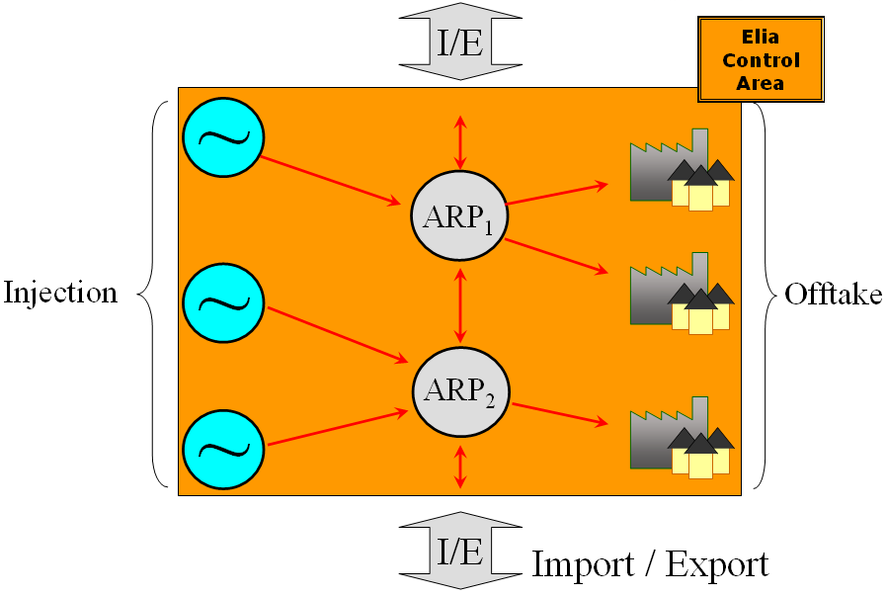
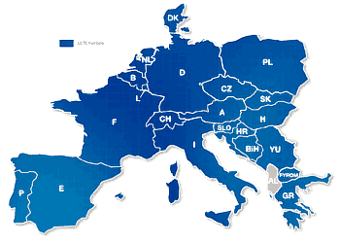
General principles of balancing
► Consumption must equal generation, otherwise: BLACKOUT!
Balance between electricity
consumption and generation: coordination between TSOs
Federal Grid Code (Art. 157(1)):
The BRP will provide and deploy all reasonable resources in order to maintain on a quarter-hourly basis the balance between total injections and total offtakes within its perimeter.
TSO ensures balance in its control area

Slide 21

Organisation of balancing in Belgium
The balancing perimeter of an ARP consists of:
        Sum of injections/offtakes belonging to perimeter
        Trading exchanges (Hub/Belpex)
        Import/exports
Import/export
Offtake
Exchanges
Injection
Offtake
ARP A
ARP B
ARP is responsible to balance its perimeter on an Qh basis
Day-ahead nominations of ARP must be balanced
ARP pays an imbalance tariff if the final position of its perimeter is not balanced
ARPs react on real-time imbalance tariffs to restore their perimeter balance/support CA ARP has the right to offer ancillary services to Elia (via CIPU contract)
Adequate incentives!
In real time, the residual imbalance of the zone is solved by the TSO
TSO will restore residual imbalances by activation of balancing services
Balancing actions by TSOs are reflected in imbalance tariffs

Slide 22
Different role of ARPs ⬄ Elia in energy markets
Balancing starts before real time and continues as close as possible to real time
FORWARD
DAY AHEAD
INTRADAY
BALANCING
LT forecasts ➔ DA forecast➔ ID forecast➔ continuous monitoring
LT-DA programmes ➔ re-dispatching of flexibility within perimeter
(centralized generation and dispatchable load) (centralised generation, flexible load)
LT purchase contracts ➔ DA & ID commercial exchanges
TSO enters in action in order to solve residual imbalances observed

Slide 23
Frequency Containement Reserve (FCR)
Objective: to maintain a balance between GENERATION and consumption (DEMAND) within the SYNCHRONOUS AREA, using “primary controllers”
The activation of FCR is based on local frequency measurment, installed by the supplier.
  Accurancy of 10mHz
  Minimum sample rate every 1-2seconds
The minimum activation time for FCR is:
  50% of the contracted value after 15seconds
  100% of the contracted value after 30seconds.

Slide 24
Automatic Frequency Restoration Reserve
Principles
Objective: aFCR maintains a balance between GENERATION and consumption (DEMAND) within each CONTROL AREA
aFCR makes use of a centralized AUTOMATIC GENERATION CONTROL,
Via a setpoint, Elia ask to modify the active power of GENERATION SETS in the time-frame of seconds to typically 15 minutes.
There are two types of regulation:
    Upwards regulation: Elia can ask to produce more electricity than scheduled
    Downwards regulation: Elia can ask to produce less electricity than scheduled
In case of multiple supplier, all suppliers are activated simultaneously and pro rata based on the total volume secondary that can be activated
Merit order activation is under discussion

Slide 25
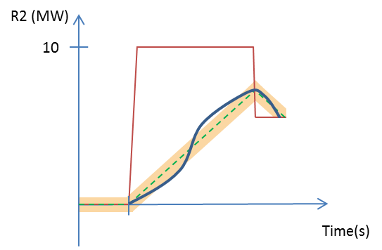
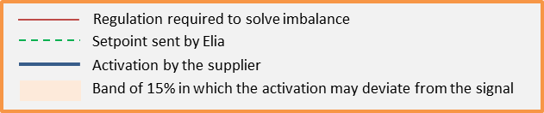
aFRR
Activation
Elia transmits a dynamic and continuous setpoint.
The dynamic setpoint, represents the volume with which the supplier must increase/decrease its production.
The supplier is required to keep the activated reserves equal to this signal.
  Maximum deviation of 15%
  The slope of the setpoint is defined by the total selected volume in a direction divided by 7,5 minutes.
  The dynamic setpoint is updated every 5 seconds.

Slide 26
Manual Frequency Restoration Reserves
Principles
Objective: Reserve power with which ELIA can restore the balance between the supply of and demand for active power within the Control Area.
Specifically: “A third line of reserve to resolve major imbalances”
  Cope with a major or systematic imbalance in ELIA control zone
  Offset a significant frequency variation
  Resolve major congestion problems
Only upwards
Activated manually
To be activated within 15 minutes
400MW from Production units

Slide 27
mFRR
Contracted capacity
Contracted capacity:
  Elia Contracts 400MW of mFRR on a yearly basis from different suppliers.
    Upwards regulation
    Peak / off-peak
  The contracted capacity must be available 100% of the time.
Free bids: Free bids are managed via the CIPU contract (coordination for injection of production units)
  Principle: all production units that are minimum stand-by (not in revision) offer their capacity to Elia on a quarter-hour basis.
  Upwards and downwards volumes.

Slide 28
Interruptible demand
Principles
Objective: Reserve power, with which ELIA can restore the balance between the supply of and demand for active power within the Control Area.
a grid user interrupts a part of its offtake in a timeframe of 3minutes
An interruption = lowering the actual offtake of that moment below a contractual fixed value, SL(“Shedding Limit”)
3 different variations of the product
  SLA2: 12 activations of maximum 2 hours
  SLA4: 4 activations of maximum 4 hours
  SLA8: 4 activations of maximum 8 hours
Different Accespoints per contract are possible. (open for aggregators)
P(offtake)
SL
Activation period
time

Slide 29
Interruptible demand
Contracted capacity
Contracted capacity:
  Elia Contracts yearly 261MW from different suppliers
    Upwards regulation (interuption of offtake)
    Peak/offpeak/weekend
  In average 100% availability during the year:
    the average reserve made available over the whole year must be at least 100%
    87 hours(1% of the time) unavailability is allowed.

Slide 30
Interruptible demand
Activation
Elia activates, by remote control, a device located in the grid user’s process
When this signal is received, the grid user’s offtake must drop below the shedding limit within 3 minutes after Elia’s request;
The offtake must remain below the SL until Elia send a deactivation signal of the maximum contractual activation time is reached:
  SLA2: maximum 2 hours
  SLA4: 4 maximum 4 hours
  SLA8: 4 maximum 8 hours
Between 2 activations is at least 24 hours
Elia cannot activate in case the Supplier has communicated unavailability to Elia (max 87h/year)

Slide 31
Introduction – balancing
► Instruments ELIA uses to maintain balance
Since Elia does not generate electricity itself, it needs to rely on the market to source a certain amount of resources in order to be able to maintain a balance:
Primary control power – R1 (FCR) (~ 83MW in 2015):
  Very fast (seconds) and automatic (based on frequency) activation
  Monthly reservation
Secondary control power - R2 (FRRa) (~ 140MW in 2015 ):
  Fast (minutes) and automatic (based on imbalance) activation
  Monthly reservation
Tertiary control power – R3 (FRRm) (~ 661MW in 2015):
  Manually activated in less then 15 minutes
  Contractual R3 = on generation units + load shedding + Inter-TSO support + as of 2014 also R3 connected to distribution grids.
  Yearly reservation
In addition to these contractual reserves, so called “free bids” are also available:
  Legal obligation for generators to make remaining margins (upwards or downwards) from each of its generation units available to ELIA.
Total budget for ancillary services amounts to ~150m/year

Slide 32
aFRR
Secondary Markets
Suppliers can exchange their contractual obligation via the secondary markets.

Slide 33
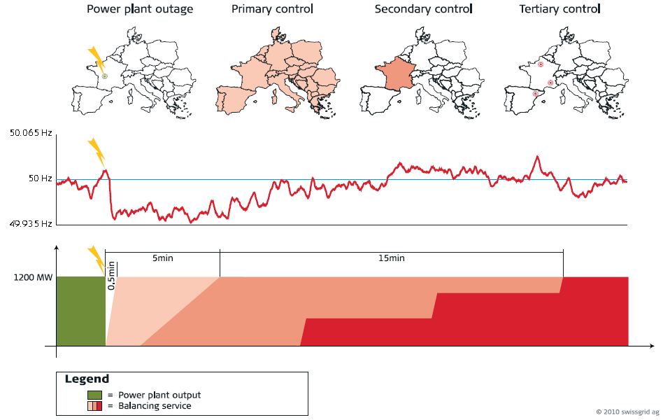
Introduction – balancing
► How are TSOs organised to maintain balance?
Technically this is achieved within the synchronous electricity grid of the UCTE in Europe by a three-stage regulation procedure (primary, secondary, and tertiary control).
Example: Power station failure in France. In the entire region, primary control is activated directly. After 30 sec, secondary control power is automatically called up in France, and replaced after 15 min by tertiary control, provided by power stations in France and Spain.

Slide 34
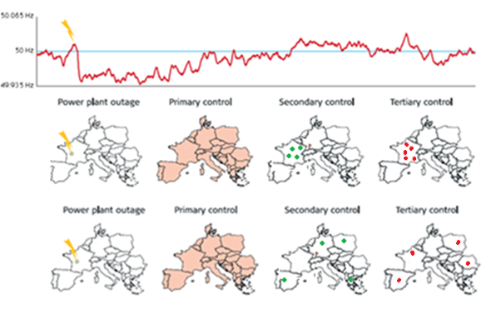
Introduction – balancing
► How will it be in the future? Network Code for Balancing
The core goal of the Framework Guidelines is to establish an European wide integrated cross-border balancing market where TSOs balance the system in a coordinated way in order to use the most efficient balancing resources taking into account transmission capacities.
Current way of balancing
    R2 requested by RTE
    R3 requested by RTE
Future way of balancing
    R2 requested by RTE
    R3 requested by RTE

Slide 35
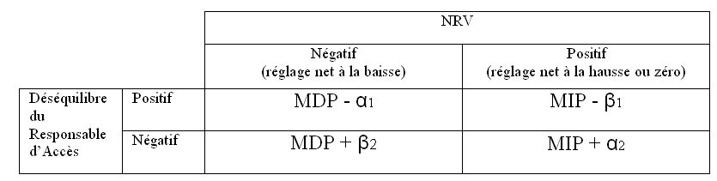
General principles of balancing
► TSO balancing actions are reflected in imbalance tariffs
  Reminder: objectives of imbalance tariffs:
      Incentive to avoid imbalances and not to source on real time market
      Incentive to favour imbalances which are helping to resolve the system imbalance (important for demand side management)
      Incentives to execute requested control power
      Transparency; real time publication
      XB harmonisation
Price ranking of activated volumes:
ARP → Elia
Elia →ARP
MIP
MDP
ARP → Elia
GDV
GUV
Elia →ARP

Slide 36
General principles of balancing
► Activations not taken into account
All activations in order to resolve congestions in the ELIA zone (I/D, tertiary reserve, load shedding)
All activations in the purpose of international redispatching (=border congestions)
All activations in order to provide energy to other TSOs (inter-TSO injections to RTE/TenneT at their request)
Those activations (costs) do not influence the imbalance tariffs (directly)

Slide 37
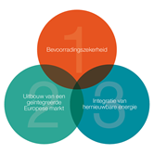

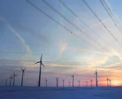




Drivers changing our world
Community / political
Market / technologies
Belgian Energy Policy
Nuclear phase out
New technologies
(HVDC)
De-central
production
New roles “Prosumers, aggregators”
Need for new
infrastructure
Fragmentation of the energy landscape
Public
acceptance
New Business Models

Slide 38
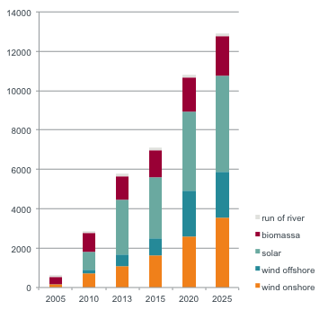
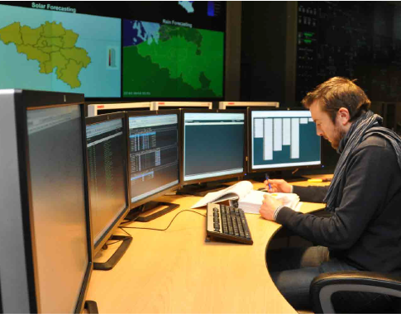
Challenge : RES integration Belgian figures
MW
Belgium is N°3 worldwide in offshore wind capacity

Slide 39
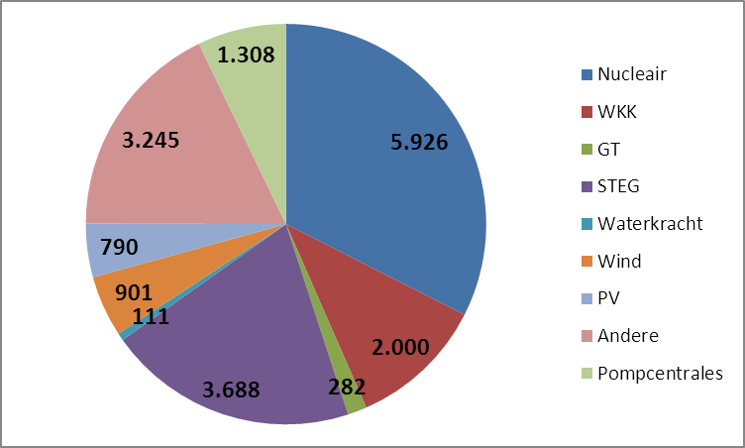
Context and challenges for balancing
► Plenty of challenges… in BE (2/2)
Limited (flexible) fossil plants
  5500MW inflexible Nuclear (biggest 1076 MW)
  3700MW CCGTs but non-spinning
  Green energy inflexible by subsidy schemes (€/MWh)

Slide 40
Possible solutions: working on different axis
Improve System Imbalances at the source (ARP):
Enhance balancing publications: e.g. wind and solar forecastings
Continued market integration (NWE intraday, etc.)
Diversify assets providing balancing services:
In 2013 – FCR/aFRR contracts revised to allow a variety of assets
Load participating in supply of FCR (2013)
Realise XB-synergies:
Single marginal imbalance tariff since 01/01/2012
Etc.
Participation of aggregators in the supply of interruptible load (2013)
RES,
Participation of BE to iGCC (imbalance netting with 6 countries incl. DE)
Intensive participation in the Network code drafting team
Study into potential BE-NL XB synergies (with Tennet NL)
Further investigations for iGCC evolutions
Etc.

Slide 41
Strategic Reserves –
“Plan Wathelet”
The creation of the strategic reserves is part of the “Plan Wathelet” which was initiated by Secretary of State for Energy Wathelet with the aim of guaranteeing Belgian electricity security of supply in the future.
The “Plan Wathelet” consists of several elements:
Reinforcement of the profitability of existing power plants and thereby avoiding their decommissioning
A public tender aiming for 800 MW of new gas-fired units
10 year lifetime extension of the nuclear plant Tihange 1
Creation of strategic reserves
Increasing interconnection capacity
Improving demand side participation

Slide 42
How do Strategic Reserve work?
High Level market Design
1. Detection
2. Notification
3. Verification
4. Injection & Balancing
Economic trigger based on Belgian curtailment in Belpex
Select & inform SR for warming
Verify the need for SR before going over to actual injection
SR actually injects
Take a decision on actual injection
Impact on balancing prices depending on real-time situation
Technical trigger based on technical system assessment
5 hours
Warm up
1,5 hours
Ramp up
D-1 until 18h,
follow-up Intraday
Real-Time
minus 6,5 hours
Real-Time
minus 1,5 hours
Real-Time
The market is informed on all important steps during this process.
Elia-DSO Workshop – 13 June 2014

Slide 43
Strategic Reserves
Difference with Balancing Reserves?
Balancing reserves (primary, secondary and tertiary control) are designed and dimensioned for compensation in real-time of (residual) imbalances caused by the different Balancing Responsible Parties in our control area. Such residual imbalances are, for example, caused by forecasting errors (on wind, solar and load) and/or forced outages of power plants, etc…
        Balancing reserves are not designed (very fast activation required) nor dimensioned (not enough) to maintain security of supply.
Strategic Reserves are designed for situations where the total consumption of the control area can’t be covered by the installed generation capacity in our control area, taking imports from other countries into account. The strategic reserves will thus be activated to avoid forced curtailment of load.
        Even in situations of structural shortage, residual imbalances can still occur meaning that the availibility of the balancing reserves must be preserved.

Slide 44
Impact on the balancing market
Changes in imbalance pricing depend on two conditions:
Has there been a trigger for strategic reserves?
Is there a structural shortage (in real-time)?
 |  | REAL TIME INDICATOR
 |  | No structural shortage | Structural shortage SI ≤ - IBIDs during last 2 qh
DETECTION | No SR trigger | Normal imbalance pricing
 | SR trigger (econ. or tech.) | Corrected price, reflecting situation without SR injection ➔ Based on ARC (Available Regulation Capacity) | Strong (single) price signal for current qh 4.500 €/MWh (winter period 2014-2015)
Only when two conditions are fulfilled, a very high price will occur

Slide 45
Agenda
Elia Group
Electricity market
Role of the different players
Elia products and services
Balancing
Other Ancillary Services

Slide 46
Other System services
Black start – MVAR
Black Start
If black out occurs….
Restore critical load (10%) after 7 hours
Restore complete load after 14 hours
For 5 zones in Belgium (NW, NE, SW, SE et Centre) one black start unit of at least 200MW is foreseen
MVAR – Voltage
MVAR needed for quality of voltage – local
Different sources:
    Investments: Self (inductive) or capacitor(capacitive)
    Contract producers

Slide 47
Grid losses
Federal grid losses
Federal Grid code (380/220/150 kV)
Grid losses need to be compensated in kind: BRP’s need to inject a % more than the offtakes.
+/- 950 GWh a year
Currently +/- 1%
Regional grid losses
Regional Grid code (70/36/30 kV)
Grid losses need to be purchased by the system operator
+/- 500 GWh a year

Slide 48
Conclusion
Elia as Transmission System Operator is a neutral player in the electricity market
The TSO is responsible for Building, Maintaining and Operating the grid
Operating the system means:
  Short term planning and coordination
  Balance management
  Congestion management – system security – voltage management – contingency management
To fulfil his tasks, the TSO relies on Grid Code, Regulated contracts and Ancillary services

Slide 49
Thank you !
http://www.eliagroup.eu/
http://www.elia.be/en/products-and-services/balance

